Slide 1
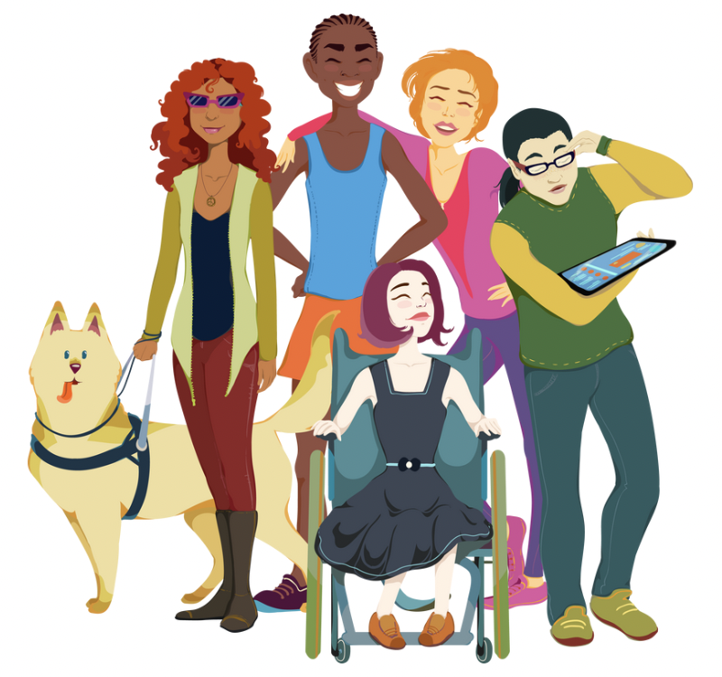
INDEPENDENT LIVING PHILOSOPHY
A program, a movement, and a culture

Slide 2
What is the Independent Living Philosophy?
Independent Living is a philosophy and a way of life
The IL philosophy says that every person, regardless of disability, has the potential and the right to exercise individual self-determination
Its goals for individuals with disabilities are empowerment and self-determination
Its goals for communities are achieving equal access through reducing and removing barriers.
The outcome we want is self-determination and full community participation for persons with all disabilities

Slide 3
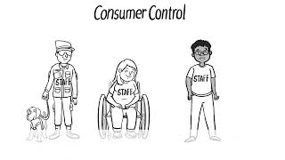

Slide 4
The History of Independent Living
People with disabilities have been defined as objects of shame, pity, fear, or ridicule throughout time
Colonists in the early USA made laws that restricted the immigration of people with disabilities because they were thought to need too much support
During the 1800s and early 1900s, disability was considered God’s will. Religion encouraged people to be compassionate and pity people with disabilities. People with disabilities were expected to be patient, uncomplaining, and humble and to make themselves useful.

Slide 5
Up until 1920, people with disabilities were mostly placed in institutions, many of which were established for custodial care (custodial care is help with daily living activities like showering or eating) with no education available. In 1841, Dorothea Dix traveled across the United States to observe and report their living conditions

Slide 6
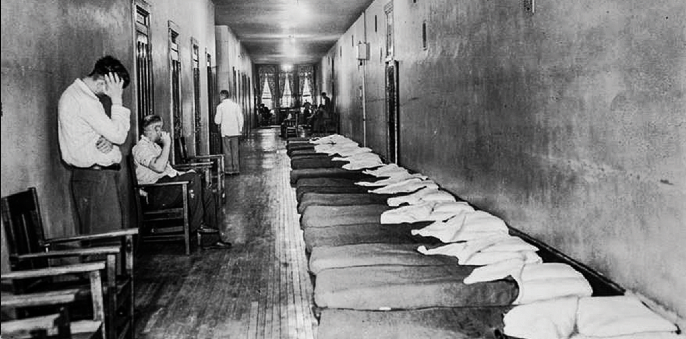
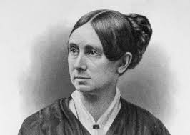
Dorothea Dix

Slide 7
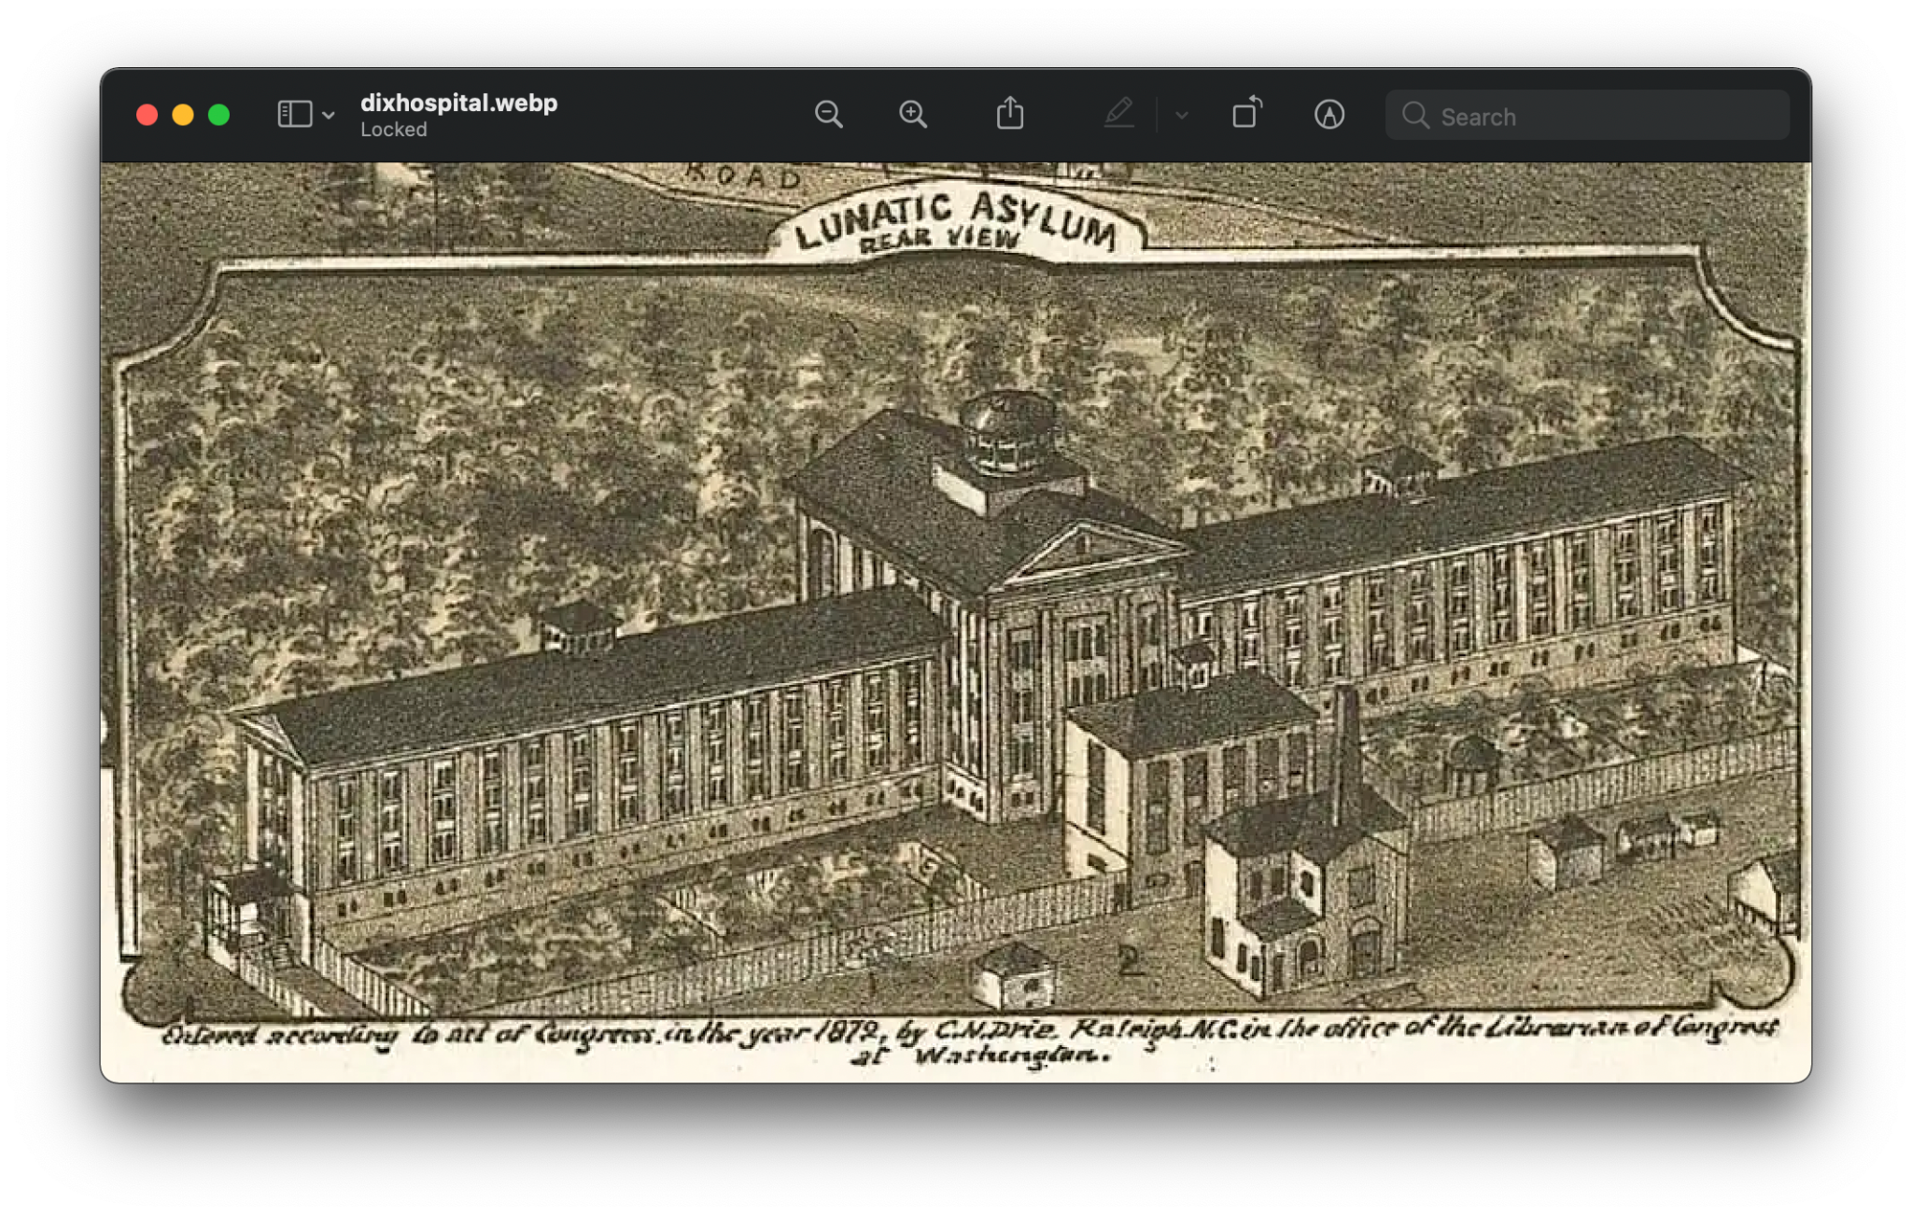
https://www.northcarolinahealthnews.org/2019/12/12/as-a-new-dix-park-gathers-momentum-sites-history-provides-complex-context/

Slide 8
“I saw people getting shock treatments.”
Former employees said that shock treatment was a worrying procedure. During this therapy, as many eight staff people stood by to restrain the patient, who had seizures when an electric shock was administered.
Prescriptions of the relatively new drug Thorazine meant patients acted less violent but also became less animated to the point of being “like zombies.”

Slide 9
Cannady [former employee of Dorothea Dix] described a procedure during which patients thought to be unmanageable or violent were wrapped in nine ice-cold sheets and left wrapped in the sheets, sometimes screaming, until they relaxed, grew warm, and went to sleep, she said.
Other patients, not diabetics, were deliberately put into insulin shock and into straitjackets so that they wouldn’t hurt themselves when they recovered.

Slide 10
Eugenics
Eugenics- a set of beliefs and practices that aim to make the genetic quality of humans better
Historically, eugenicists have attempted to alter human gene pools by excluding people and groups judged to be inferior or promoting those judged to be superior
Toward the end of the 1800’s and beginning of the 1900’s, the eugenics movement said that people with disabilities should not be allowed to survive or have children because they would weaken the gene pool of the human race and cause social problems
Scientists eventually disproved the basic tenets of the eugenics movement but not until after the forced sterilization of thousands of men, women, and children
Sterilization- surgery to make a person unable to produce offspring

Slide 11
Vocational Rehabilitation
Rehabilitation services on a broad scale were introduced as a federal program following World War I, specifically focused on veterans with disabilities
The need for training or re-training (for jobs/employment) of veterans to enter back into the workforce created one of the first federally funded programs for people with disabilities – now known as the federal-state vocational rehabilitation system
Other major services for people with disabilities were not seriously considered by federal legislation until the social change movements during the 1960s

Slide 12
Traditional Medical and Rehabilitation Models
The traditional medical model and traditional rehabilitation services put doctors and other professionals in charge of the decision-making about the lives of people with disabilities
The goal was often to either “fix” people with disabilities, or to separate those who couldn’t be “fixed” in institutions
The IL movement is a reaction to this and to the growing preference for people with disabilities for self-determination, civil rights, and equal access

Slide 13
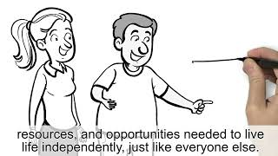

Slide 14
IL Program: Centers for Independent Living
Centers for Independent Living (CILs) are the operational and programmatic aspect of IL. These are non-profit and consumer-controlled organizations

Slide 15
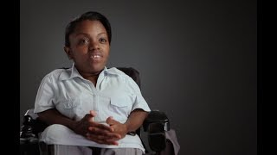

Slide 16
IL Movement
The process of deinstitutionalization began in the 1960’s, and included people with significant disabilities getting out and into their communities.
Our first taste of freedom came amidst massive civil rights movements nationally and abroad. Leaders of the disability community began to realize that our human rights and civil liberties would come only as we fought for them. With most state-run institutions closed, people with significant disabilities became more visible, and more audible, too. Society’s unwelcoming attitude did not change.

Slide 17
5 Social Movements
Deinstitutionalization- based on the idea that to achieve “normal” behavior, the person should be in as “normal” a setting as possible
The Civil Rights movement- raised awareness about achieving equal rights under the law. This opened the door for making it illegal to discriminate in employment based on disability
The Self-Help movement (Peer Support)- asserted that people who share similar experiences are more likely to understand each other and provide more effective assistance

Slide 18
4. Demedicalization- looked at more holistic approaches to health care with individual empowerment and responsibility for defining and meeting one's own needs
5. Consumerism- questioned product reliability and price leading to the fundamental belief that consumers of goods and services should have control over the choices and options available to them

Slide 19
Independent Living activists carried out some of the most daring protests in American civil rights history, including the longest occupation of a Federal building in history, which led to the release of the regulations banning discrimination against people with disabilities in federally funded programs.
As IL philosophy took hold nationally and the disability rights movement gained acceptance and political influence, a grassroots movement for a comprehensive disability rights law (the ADA - Americans with Disabilities Act) was implemented.

Slide 20
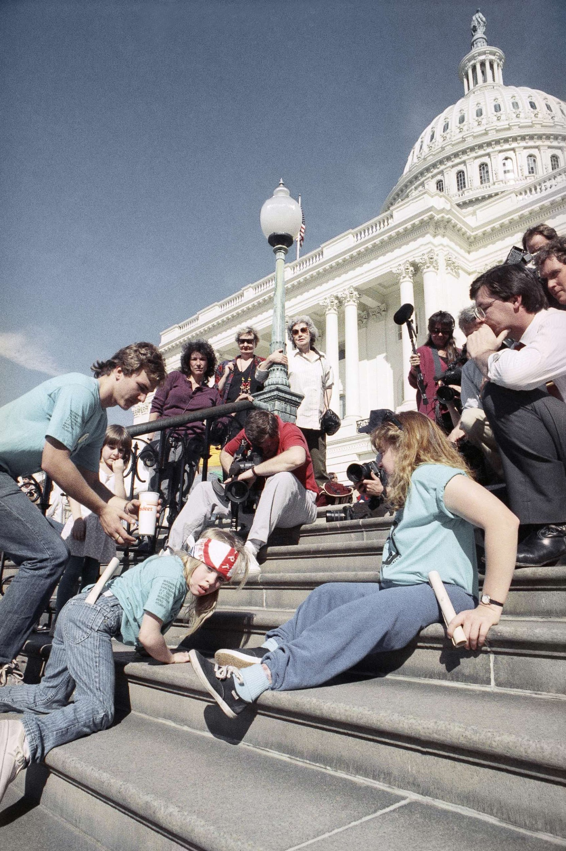
Pictured: Jennifer Keelan, 8 years old, climbing the steps at the Capitol. It took her an hour to climb all of the stairs.
Capitol Crawl video
@myelasticheart on TikTok

Slide 21
IL Culture
The IL Movement is founded in the belief that people with disabilities have a common history and a shared struggle, that we are a community and a culture that will advance further by coming together politically.
Independent Living philosophy emphasizes consumer control, the idea that people with disabilities are the best experts on their own needs and deserving of equal opportunity to decide how to live, work, and take part in their communities, particularly in reference to services that powerfully affect their day-to-day lives and access to independence (for example, Personal Care Assistants)

Slide 22
The IL philosophy sees that the problem lies in the environment, not the individual. Though many people have physical, intellectual, or mental attributes that are “not normal,” disability is displayed in society through purposefully created and maintained physical, programmatic, and attitudinal barriers.
People with disabilities do not see themselves as problems to be solved, and ask only for the same human and civil rights enjoyed by others. Unfortunately, this viewpoint is not generally accepted in society today.

Slide 23
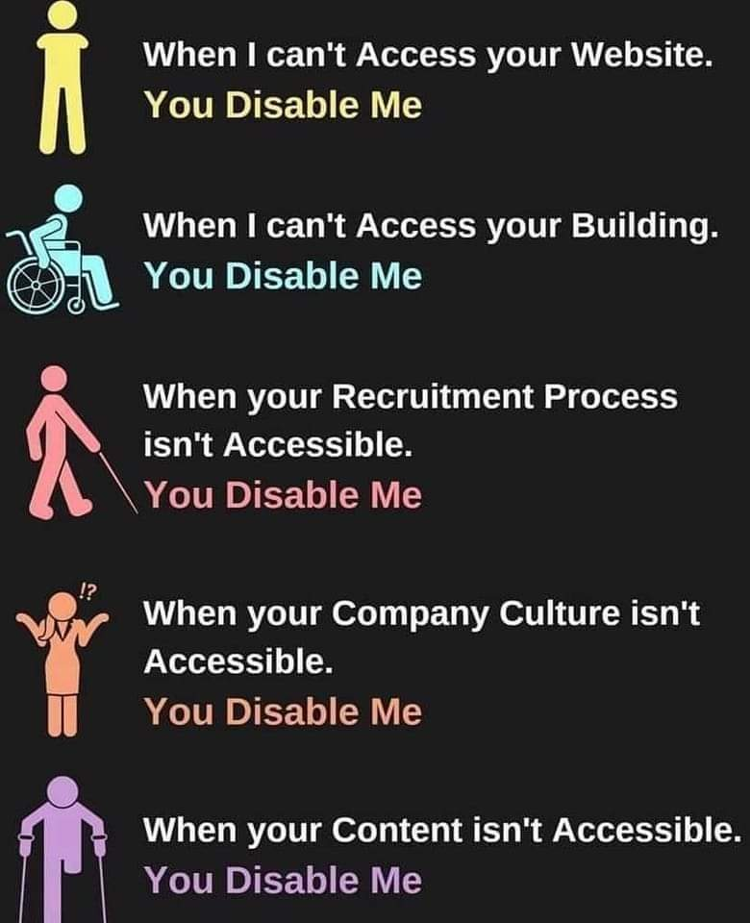

Slide 24
What are some things you’ve experienced that make it harder for you to live independently - like making your own choices, living on your own, or getting a job?

Slide 25
Common Barriers to living independently:
Lack of transportation - affecting access to healthcare, employment, food, social engagements, education, and affects mental health
Lack of affordable and accessible housing
Lack of healthy and affordable foods
Constant struggle to get accommodations
Public access issues
Disability discrimination and societal views on disability
Family and friend’s opinions on what they think you need
Success in educational settings through lack of proper resources and support for students with disabilities
Inaccessible transportation (ex. airplanes)
Poverty and forced poverty through SSI and SSDI
Internalized ableism
Lack of PCAs
Costs from disability technology needed and not covered by insurance or taking long times to get approved
Difficulties getting proper mental health help

Slide 26
In summary:
Much of our society has not viewed people with disabilities as equal as able-bodied people, and this affects our quality of life
The IL Philosophy says WE get to choose how to live our lives and that WE know what’s best for us
The things we talk about at the Youth Leadership Forum are all based around the IL Philosophy - we want youth and young adults to learn about how live the lives they want and about their rights (which are STILL being fought for today!!!)

Slide 27
Sources & More Info
IRLU.org
https://www.accessliving.org/newsroom/blog/independent-living-history/
https://ncil.org/

