Slide 1
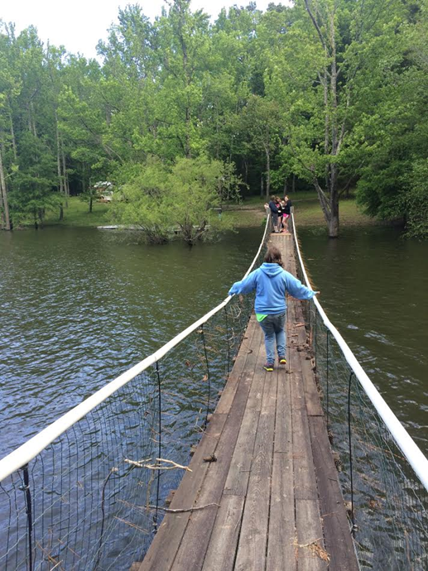
Disability Pride/Ableism
By: Kelli Hutson

Slide 2
Why do we need Disability Pride
Many disabled people are exposed on a regular basis to ableism. Ableism is present throughout society, and can take the form of condescending, rude, or abusive attitudes towards people with disabilities, leading to lack of accessible and inclusive services and communities.
Disability pride is a tool to fight against ableism by affirming one’s self-worth as a disabled person in an ableist society.

Slide 3
What is Ableism?
Ableism is a harmful way of viewing people with disabilities
It implies that people with disabilities need to be “fixed” and it puts someone’s disability before other things about them - their personalities, their likes and dislikes, etc.
Ableism affects how people are treated
Examples of Ableism:
Telling someone they do not look disabled
Denying someone a job because of their disability
Believing that all people with a disability need help

Slide 4
How to treat people with disabilities
Respect people with disabilities and their decisions
Promote accessibility
Include people with disabilities in your community and conversations
Don’t assume the needs of a person with a disability
Educate others on the importance of anti-ableism
Hold organizations and politicians accountable
Fight for an inclusive society

Slide 5
People with disabilities are just like everyone else!
Goals
Jobs
Dreams
Respect
Independence
Relationships

Slide 6
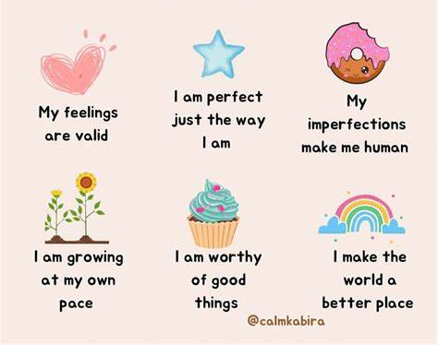
Positive Self Talk
There will always be people who will judge you or not understand you. That isn’t your fault or something you need to fix. Be yourself and the right people will love and accept you for who you are. Be kind to yourself, not just other people!

Slide 7
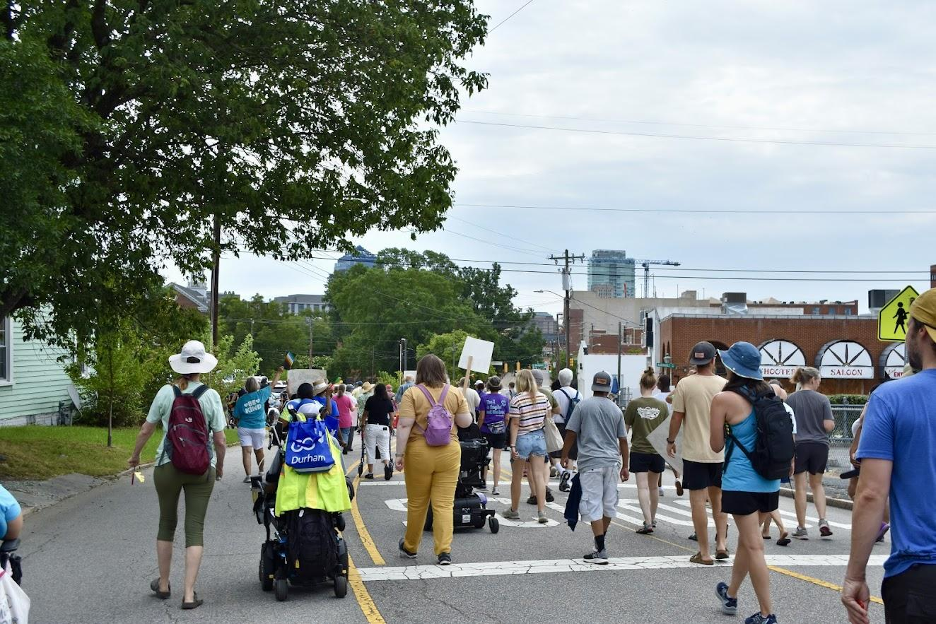
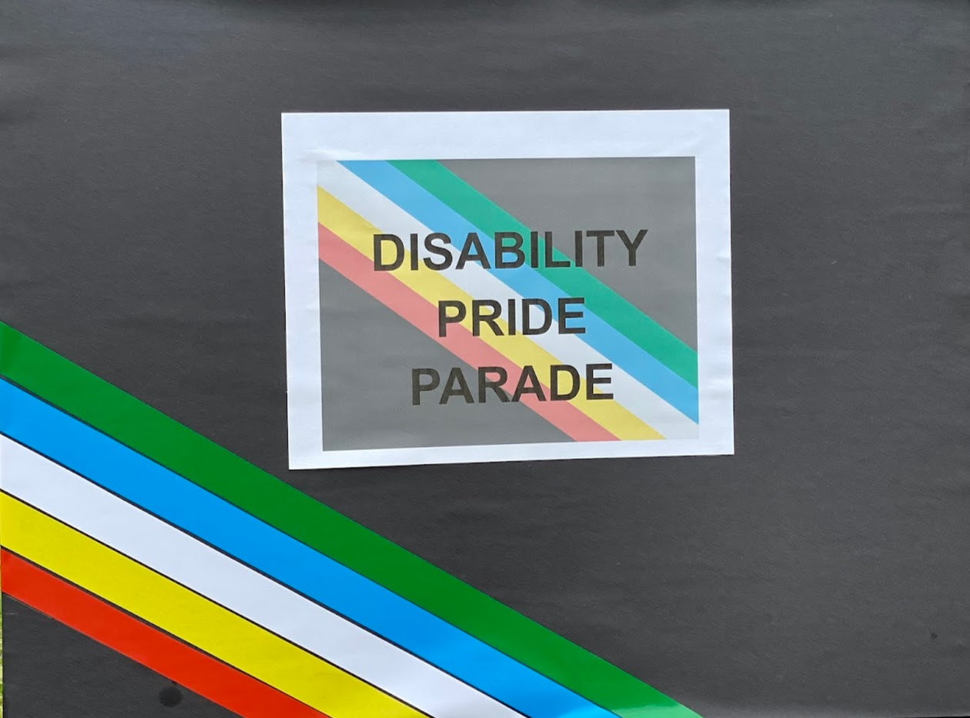
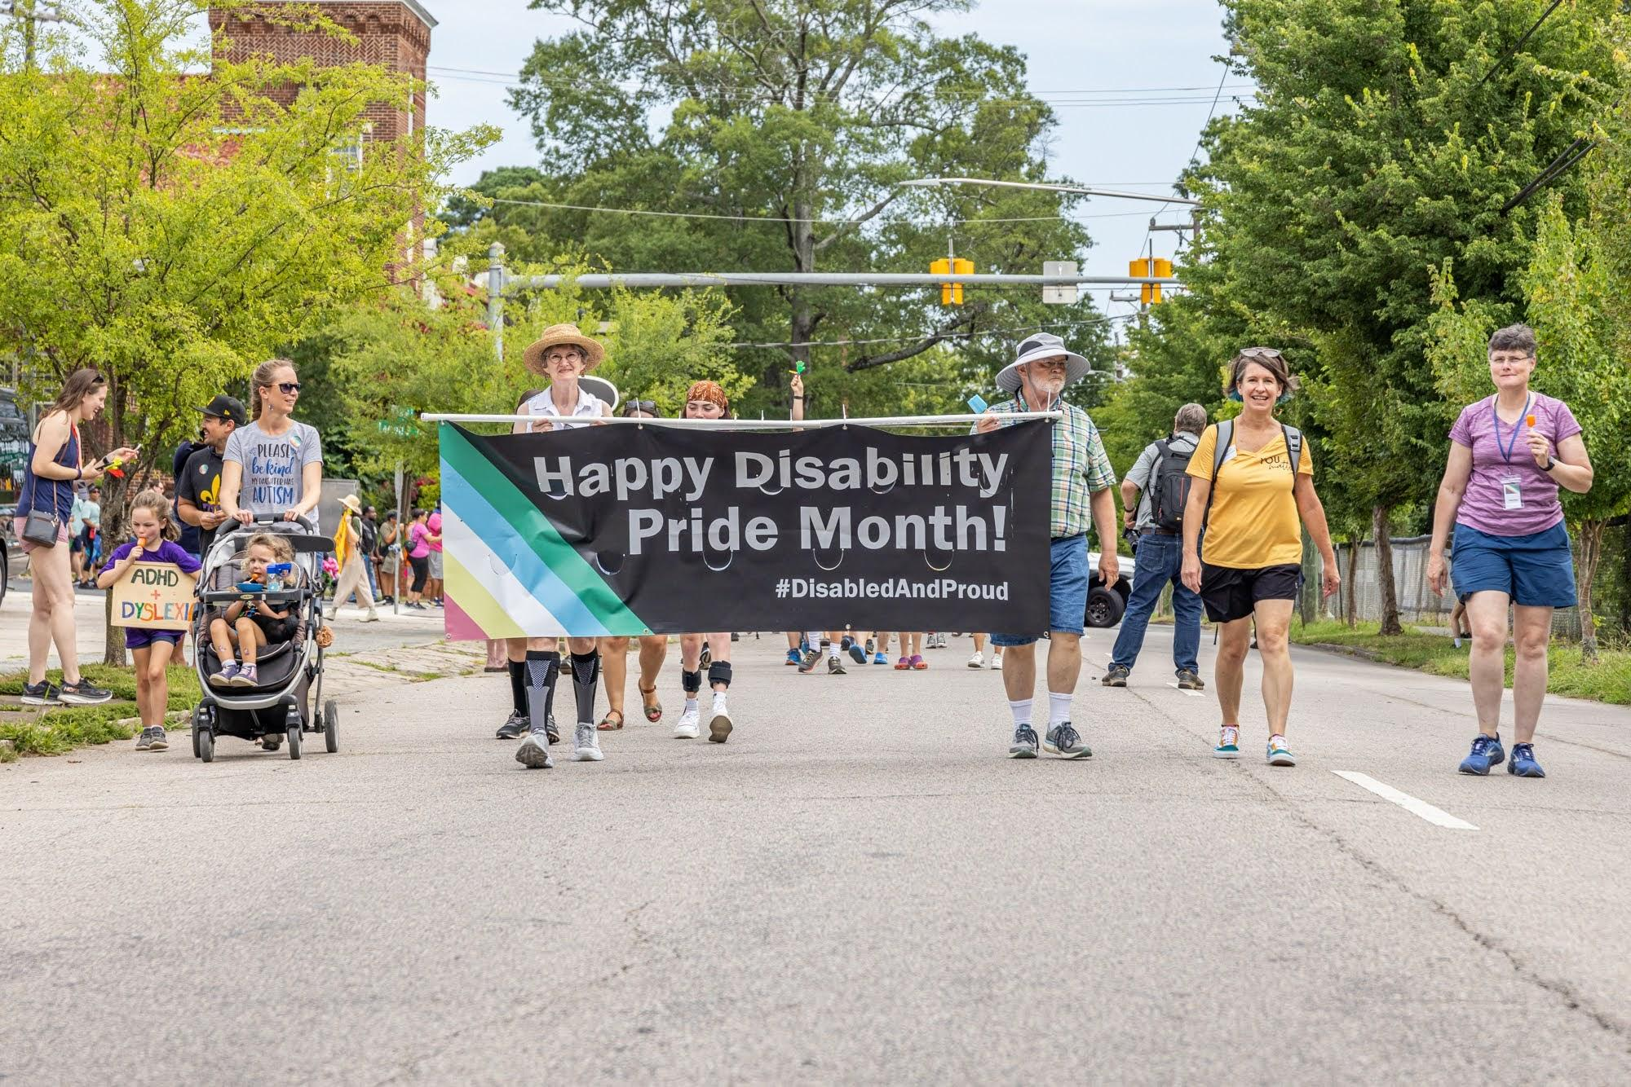
What Disability Pride means to me
To be proud of your identity, no matter the disability.
I attended the Disability Pride Parade in Durham last year and met lots of people with all kinds of disabilities. Everyone had a great time celebrating their differences and there were lots of positive messages.

