Slide 1
Systemic Advocacy
Jay Pande

Slide 2
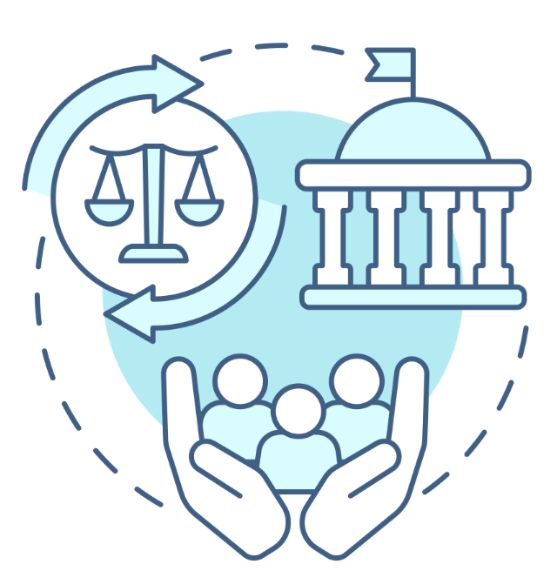
What is systemic advocacy?
Systemic advocacy is about working together to create broad changes in policies, laws, or rules at the local, state, or federal level BY:
Working closely with government agencies and/or non-government organizations to make it easier for people with disabilities to get around, be a part of groups, and have equal chances.
This includes such things as working for better public transportation, more accessible infrastructure, education for everyone, increased job prospects, and more

Slide 3
Why is systemic advocacy important?
It helps to
eliminate systemic barriers
ensure people with disabilities have access to services
fight for the rights of people with disabilities
Systemic advocacy is important in changing laws and policies that affect people with disabilities
Laws and policies like: The Fair Housing Act
Does anyone remember what the FHA is and how it affects people with disabilities?

Slide 4
Ways to practice systemic advocacy
Meet with leaders of state agencies and comment on proposed regulations
Help legislators draft bills and advocate for changes in state law
Testify at public hearings of state agencies and the legislature
Meet with stakeholders in the disability community and other nonprofits to
help coordinate resources
understand priorities and goals of the community
build coalitions for advocacy work and training
Learn what is going on in NC - the issues that our government and advocates are currently facing and working on
Example: Hearts For Homecare
Sign up for newsletters from organizations that practice systemic advocacy

Slide 5
Systemic advocacy in North Carolina
Advocacy on webinars or advisory committees with state officials (e.g. NC Department of Health and Human Services)
North Carolina Council on Developmental Disabilities
HOPE NC (housing/community living for people with disabilities)
NAMI (National Alliance on Mental Illness) NC
Vote in local, state, and national elections!
Practice advocacy by doing things like what we did with the Pullen Park project!

Slide 6
Discussion Questions
Tell us about a policy or law that affects your ability to live independently. Think back to when we talked about the Independent Living Philosophy.
How can you advocate for changes to this policy that help you and others with disabilities?
What are some barriers you might experience when doing systemic advocacy?
How could you overcome these barriers?
Notes:
Think back to when we talked about the Independent Living Philosophy.

Slide 7
How could working together with a group of your peers help you make more change?
Not everyone is able to easily travel, go to protests or events, or meet with lawmakers. How can you practice systemic advocacy at home?

