Slide 1
The Fair Housing Act (FHA)
Meredith Huml

Slide 2
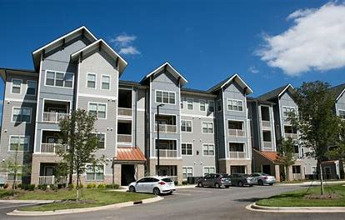
Housing is a major part under the umbrella of the Independent Living Philosophy that we have discussed. We deserve to live in a safe space in the community of our choosing, and to live as independently as possible.

Slide 3
The Fair Housing Act of 1968
The Fair Housing Act says that landlords, sellers, and homeowner’s associations cannot discriminate against people with disabilities. This means that they cannot refuse to rent to you or treat you poorly because you or your family member have a disability.

Slide 4
Accommodations in housing
A reasonable accommodation is “a change, exception, or adjustment to a rule, policy, practice, or service that may be necessary for a person with a disability to have an equal opportunity to use and enjoy a dwelling, including public and common use spaces.”
Examples of housing accommodations:
Having an emotional support animal in an apartment that doesn’t allow pets
Placing a mailbox in a more accessible place
https://www.youtube.com/watch?v=9X-QvveaOko
What are some accommodations you may need or have asked for at some point?

Slide 5
To qualify for a reasonable accommodation in your housing, you must have a disability and the reasonable accommodation must be necessary to give you an equal opportunity to use and enjoy your home. A landlord’s failure to grant a reasonable accommodation request is discrimination. BUT, if the request is not reasonable, the landlord doesn’t have to grant it. A request is not reasonable if it would cause an undue hardship or if it would somehow fundamentally change the landlord’s business.

Slide 6
Modifications in housing
A reasonable modification is a physical change to a structure or its surroundings that you need because of your disability. Landlords must allow reasonable modifications in housing, but renters usually pay for the modification. Examples of modifications:
Installing ramps
Installing visual-alerting fire alarms and doorbells
What are some modifications you may need or have requested at some point?

Slide 7
You need to ask for the reasonable accommodation or modification in writing, and you have the right to ask for one at any time.
Landlords may not ask for your specific diagnosis, or any other detailed or extensive information or documentation related to your disability. Housing providers are never entitled to your medical records.
Landlords cannot insist that the documentation be provided in any particular form. For example, if your landlord says that you have to use a particular form for your request, or if the landlord asks that your doctor fill out a particular form, you do not need to do that. Instead, you can submit letters from yourself and your doctor (such as the examples at the end of this packet). You can fill out your landlord’s preferred forms if you want, but you do not have to.

Slide 8
If you think your housing rights are being violated, you have two options: you can file a housing discrimination complaint or you may file a lawsuit in court.
If you want to file a housing discrimination complaint, you may contact the following agencies:
NC Human Relations Commission – (919) 431-3103 or toll free at 1 (866) 324-7474 or https://www.oah.nc.gov/civil-rights-division/housing-discrimination.
Department of Housing and Urban Development (HUD) – (800) 669-9777 or https://www.hud.gov/program_offices/fair_housing_equal_opp/online-complaint
More information about your housing rights, or to find an attorney, contact:
Disability Rights North Carolina – (919) 856-2195 or disabilityrightsnc.org
Fair Housing Project of Legal Aid of NC – (855) 797-3247 or fairhousingnc.org
It is important to document everything! Write everything down. If you can, communicate with your landlord through email so that you have evidence in case you need to file a complaint or a lawsuit.

Slide 9
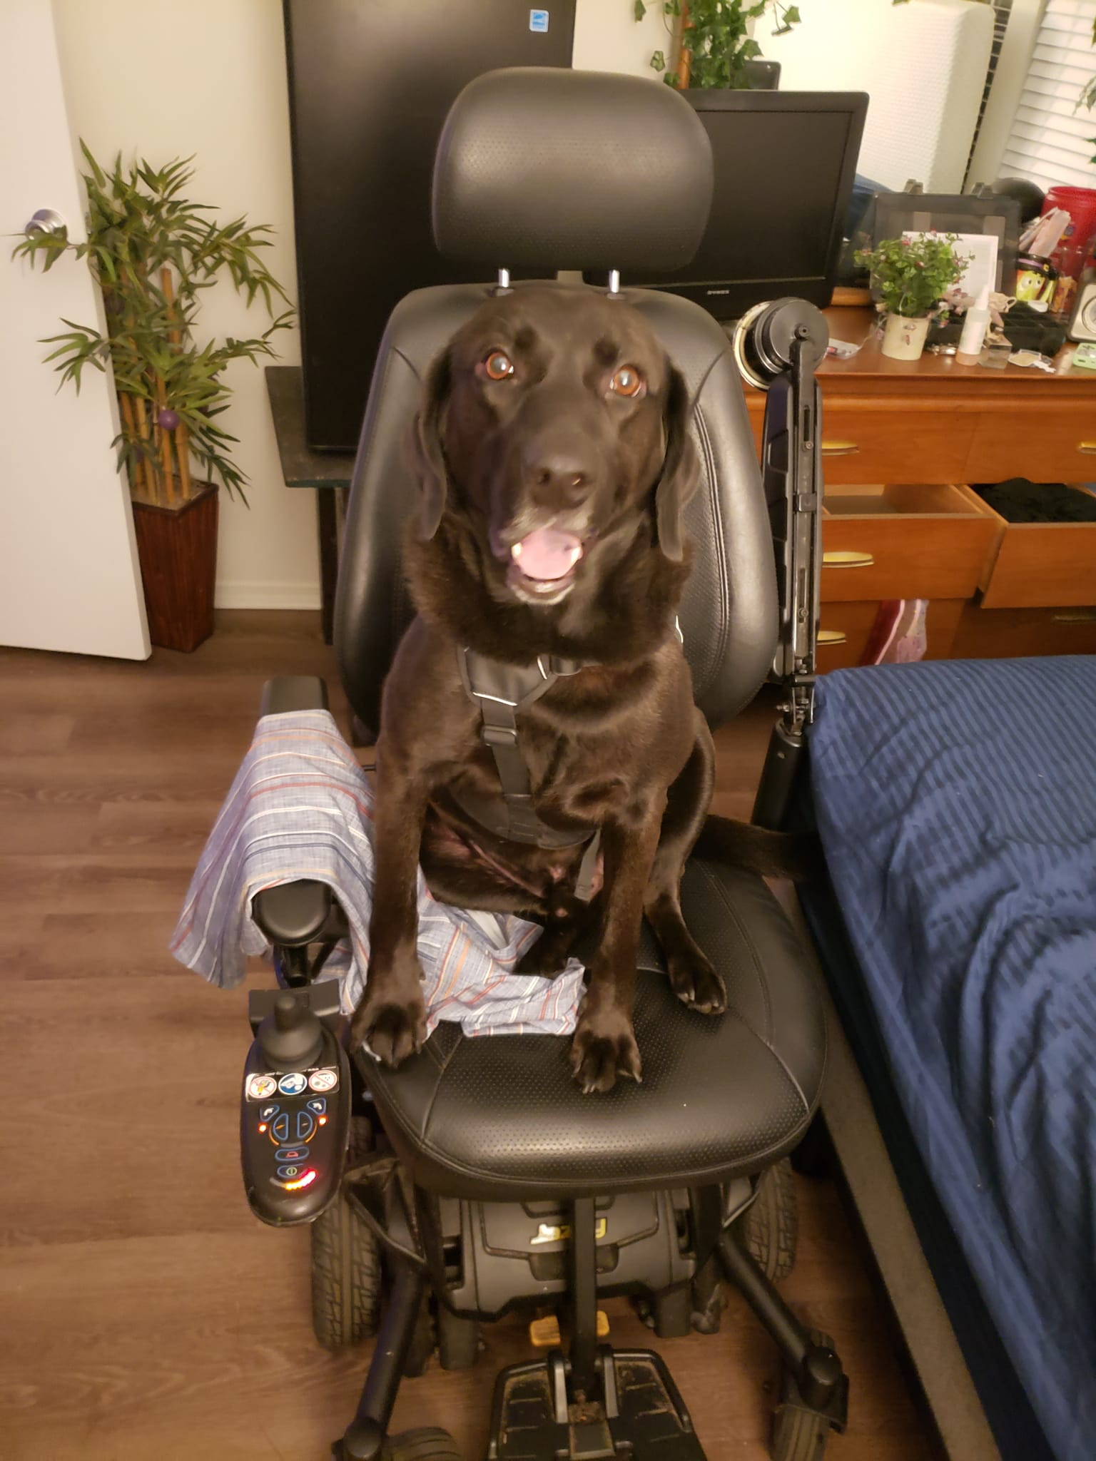
Questions?

