Slide 1
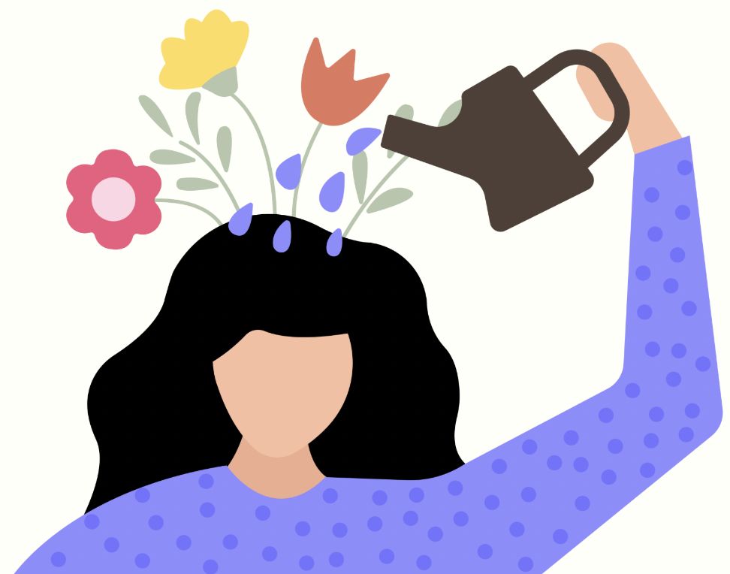
Self-Care

Slide 2
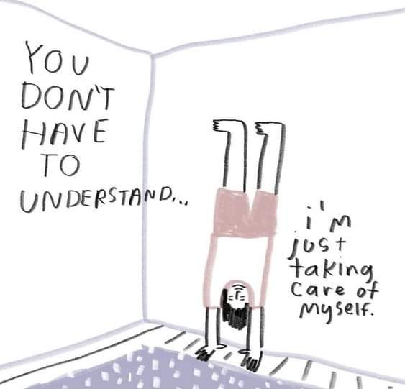
Agenda
Introduction
5 types of self-care
Physical
Social
Mental
Emotional
Spiritual
Setting boundaries
Practicing gratitude
Disability and self-care

Slide 3
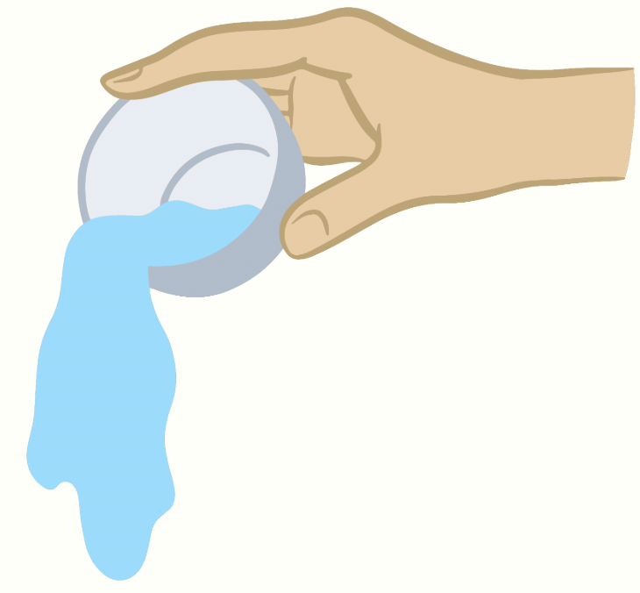
You can’t pour from an empty cup!
In order for us as humans to effectively take care of others, put our energy into things we love, and reach our goals, we must first take care of ourselves.

Slide 4
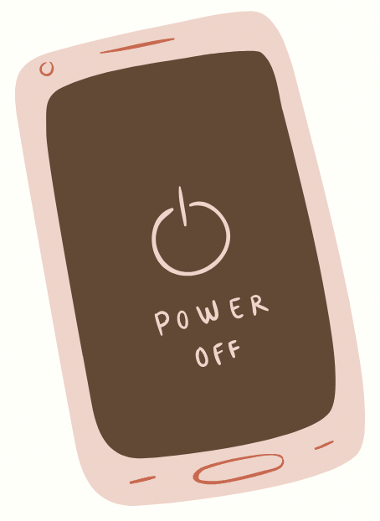
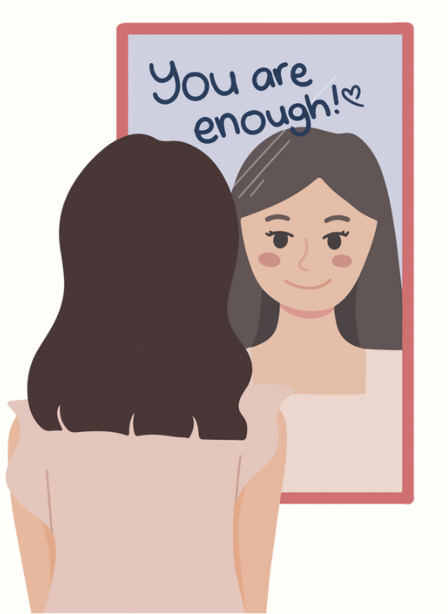
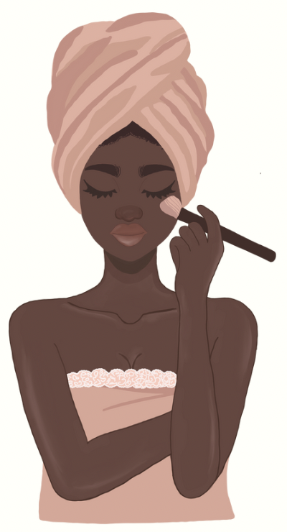
There are many different forms of self-care…
Physical
Social
Mental
Emotional
Spiritual
https://www.youtube.com/watch?v=bARpudRvNgA

Slide 5
Physical
The mind and body connection is very important! When you are caring for your body, you’ll think and feel better too. Physical self-care includes how you're fueling your body, how much sleep you're getting, how much physical activity you are doing, and how well you're caring for your physical needs

Slide 6
Social
We are not meant to live in total isolation - we all need social connections in our lives, whether we are introverts or extroverts! Although it can be hard to make time for family and friends, or make friends, close connections are important for our well-being
Examples of how we can take care of ourselves socially?

Slide 7
Mental
Humans have about 6200 thoughts in a single day!!
Our self-talk affects how we think and feel about ourselves.
It’s also important to stimulate your mind with mental activities.

Slide 8
Emotional
It is important to have healthy coping skills to deal with uncomfortable emotions like anger, anxiety, and sadness.
Emotional self-care is a process in which we bring our awareness to our emotions and take the steps necessary in order to honor and care for these emotions

Slide 9
Spiritual
Nurturing your spirit doesn’t have to involve religion, though for some it does. It can involve anything that helps you develop a deeper sense of meaning, understanding or connection with the universe

Slide 10
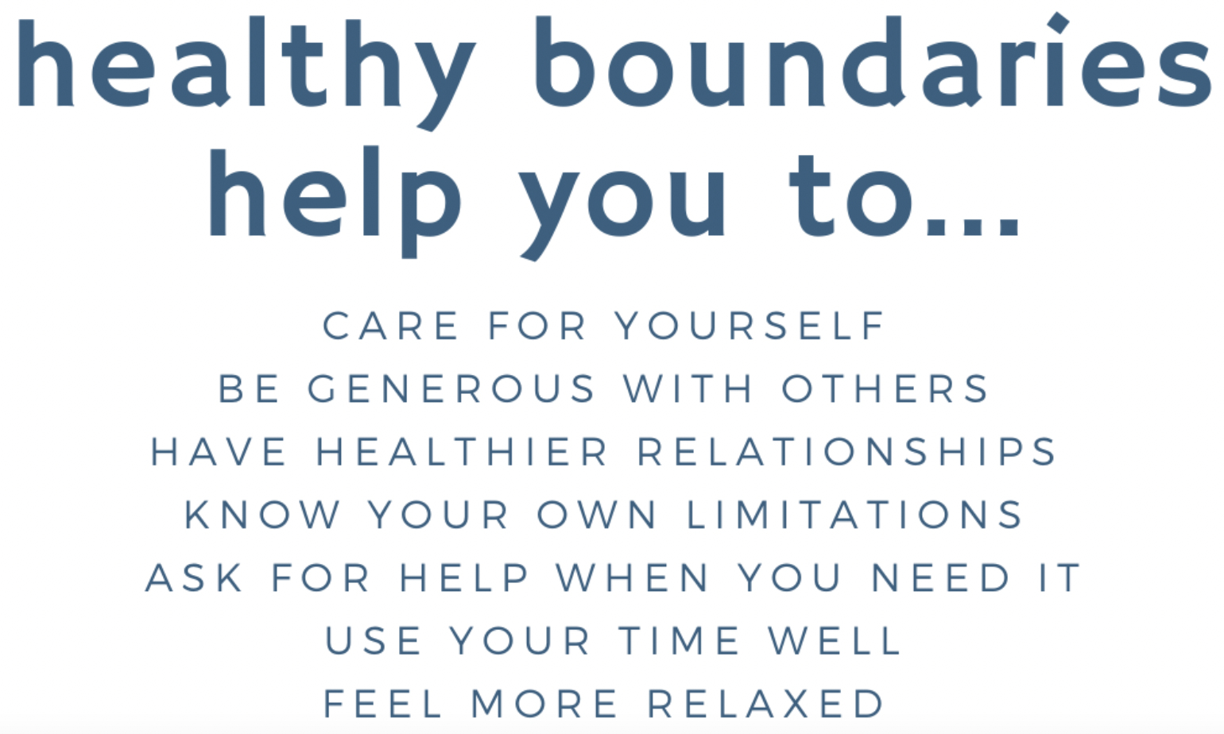
Setting boundaries
Examples:
“I need some alone tonight, so I won’t be able to go to the party.”
“I need some time to process this information before I can give you a response.”
“I won’t be able to continue this conversation if you choose to call names and yell.”

Slide 11
Practicing gratitude
Practicing gratitude and being thankful for what we have affects all of the types of self-care that we’ve talked about. It gives us more happiness, better self-esteem, better relationships, less stress, more mental resistance, and more.
Personal example: I have chronic fatigue, chronic pain, Muscular Dystrophy, Epilepsy, had to give up many of my passions because of my disabilities, and anxiety that can sometimes feel crippling. I also have a bed, a roof over my head, food to eat, friends and family who love me, I’ve gotten to experience beautiful things and adventures, I have a dog and 2 cats who always make me feel better.
Ways to practice gratitude:
Write down a list of things that you are grateful for, save it for when you’re having a tough day
Begin and end your day a “thank you” to the universe, God, or whoever you’d like!
Ex. “Thank you for giving me another day and chance to love myself and others.”
https://www.wellnessworkdays.com/post/rewire-your-brain-with-gratitude

Slide 12
How can our disabilities affect our self-care?

